Slide 1
Financing Solutions – Equipment CAPEX

Slide 2
Goals this Afternoon
Background on WBD
Vendor Financing
Conventional Bank Financing
SBA Financing Solutions:
SBA 7a Loan Program
SBA 504 Loan Program
Real Life Example – 504 Program
Questions

Slide 3
WBD Overview
Founded 1981, to assist businesses in accessing capital
Mission Driven, Not-for-Profit, SBA Authorized Certified Development Company
Consistently one of the top CDCs in the Country.
In Fiscal 2023 - #10 in the USA.

Slide 4
FY 23 – Another Busy Year

Slide 5
Industries We’re Seeing

Slide 6
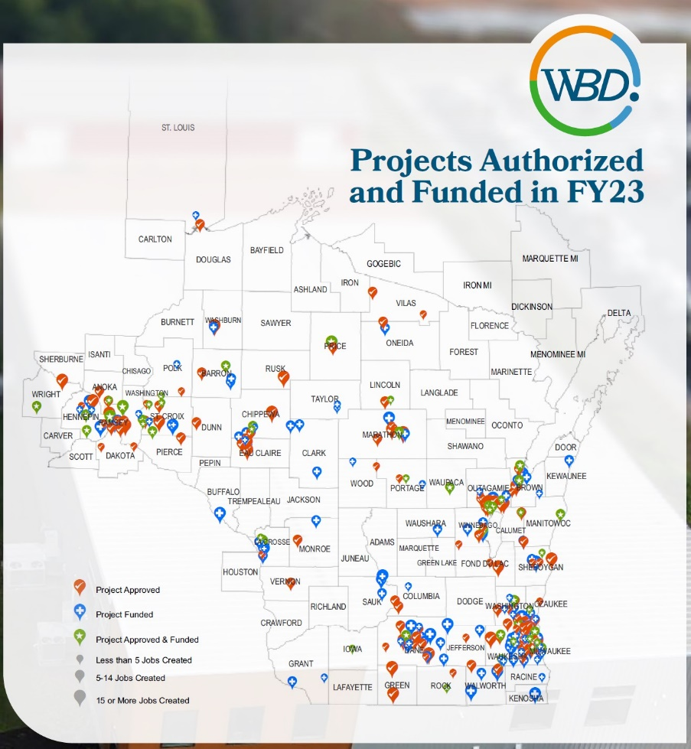
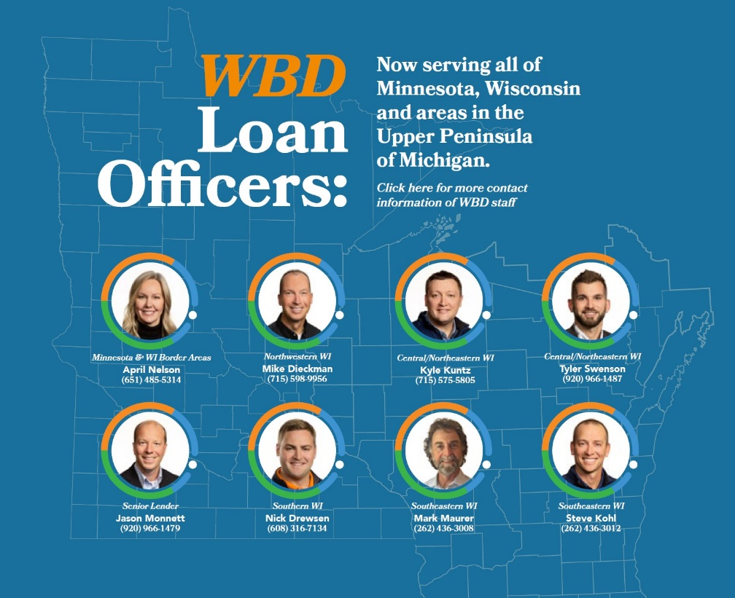
Serving all of Wisconsin, UP MI
And now all of Minnesota!

Slide 8
Vendor Financing

Slide 9
Vendor Financing
Business finances equipment directly from the equipment vendor
Terms & Conditions vary widely on the vendor and type of equipment being acquired
Low down payment – Can be 100% financed
Shorter terms / amortization – Typically 1 to 7 years
In general, higher interest rates than conventional bank financing
Vendor typically files a specific lien on the equipment being acquired
Quick turnaround times

Slide 10
Conventional Bank Financing

Slide 11
Conventional Bank Financing
Varies widely by financial institution
Typically require 15%-30% down; some larger banks will provide 100% financing on Equipment CAPEX to an established business / customer
Business typically has to pay for installation costs out of pocket
Rate and terms determined by financial institution – Amortization typically 5 or 7 years. Some lenders may stretch amortization to 10 years for longer useful life equipment.
Typically set up with a balloon note (i.e. 3 or 5 year term / rate lock, amortized over 5 or 7 years)
Financial institution typically requires a General Business Security Agreement on all assets of the company.
In some instances, they may do a Purchase Money Security Interest on the specific piece of equipment

Slide 12
SBA 7a Loan Program

Slide 13
SBA 7a Loan Program
Guarantee program – Lending institution applies for a guarantee from SBA (typically 75%).
Mitigates risk for lenders – Allows them to do a loan that may not meet their conventional financing standards (i.e. lower downpayment, longer term / amortization).
Loans up to $5MM - Loans are fully amortized
Interest Rate & Terms determined by Lending Institution, as long as they fall within the SBA’s parameters
Typically, 7a loans have a variable rate feature tied to Prime + a Spread
On Equipment, term / amortization is typically 10 years. Can be longer if supported by useful life documentation.
Downpayment determined by Lending Institution – Rule of thumb is 10%, however can do 100% financing for an existing business.
SBA requires lender to take all available collateral until the loan is fully secured (may include a 2nd mortgage on the owner’s personal residence). If all collateral is pledged and there is still a collateral shortfall, the loan can still be approved.

Slide 14
SBA 504 Program

Slide 15
SBA 504 Loan Program
Administered nationally by Certified Development Companies like WBD in participation with a lead lender (bank or credit union)
Program Niche – Projects between $500,000 - $20MM
Below Market Rates – Money funded through bond market
Fixed Rates – For the life of the loan
Long Terms – Up to 25 years
Up to 90% Financing = Less Money Down
Structure helps bank get comfortable and take on more risk
WBD can work with any bank/credit union – In FYE 2023, WBD partnered with 105 different financial institutions
Borrower friendly collateral requirements – Collateral limited to the asset(s) being financed

Slide 16
Typical 504 Financing Structure
Third Party Lender’s portion is a conventional loan
504 portion has 100% SBA guaranty

Slide 17
Long-Term Financing Commitments
20-Year or 25-Year Debenture:
Third Party Lender’s loan must have at least a 10-year maturity; amortization doesn’t need to match the 504 loan
10-Year Debenture:
Third Party Lender’s loan must have at least a 7-year maturity; amortization doesn’t need to match the 504 loan
Equipment may be financed with a 20-year or a 25-year Debenture if supported by a useful life letter from the manufacturer of the equipment

Slide 18
Long-Term Fixed Rate Financing
Current Effective 504 Fixed Interest Rates:
25 Year – 6.385% February 2024
20 Year – 6.496% February 2024
10 Year – 6.544% January 2024
10-year debentures are sold every 2 months

Slide 19
Real Life Example

Slide 20
Equipment CAPEX
Business Background & Situation:
Long established manufacturer
Well diversified customer base
Challenges with the labor market
Looking to acquire a Stopa Tower System which is the backbone of a material storage and handling system. The system features six machines that are connected, pulling materials, processing materials, and then putting the completed parts back in the tower for the next operations to pull & process.
New equipment purchases are focused on leveraging robotic & automated technologies to lower dependence on manpower
Preliminary Borrower Financing Request:
PO on Various Equipment Lines - $11,438,000*
*Includes shipping & installation

Slide 21
Equipment CAPEX
Project Considerations:
Existing business; therefore, the minimum required borrower contribution is 10%.
Can finance installation costs and shipping costs into structure
Useful life letter from manufacturer of the equipment exceeded 20 years
Bank provided a 10 year fully amortized front-end loan; 504 loan was 20 years given the useful life
Lead team for equipment install was 12 months – Bank provided an interest only draw note for 90% of the project. 504 loan closing occurs upon completion of the project to paydown the bank’s interim financing.
504 Collateral Limited to 2nd lien on specific piece of equipment
504 Structure:
Use of Funds |  | Source of Funds
Purchase & Install Equipment | $ 11,438,000 | Bank Financing |  | $ 5,734,000 | 50.0%
Soft Costs | $ 30,000 | SBA 504 Debenture |  | $ 4,587,000 | 40.0%
 |  | Borrower Contribution |  | $ 1,147,000 | 10.0%
 | $ 11,468,000 |  |  | $ 11,468,000 | 100.0%

Slide 22
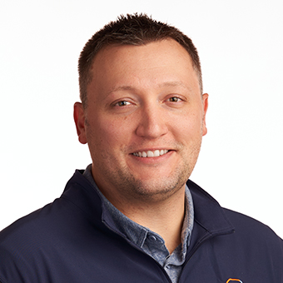
Contact Information
Kyle Kuntz
Vice President – Loan Officer
Team Lead – Northeast WI
Cell: (715) 225-4939
kkuntz@wbd.org

